Slide 1
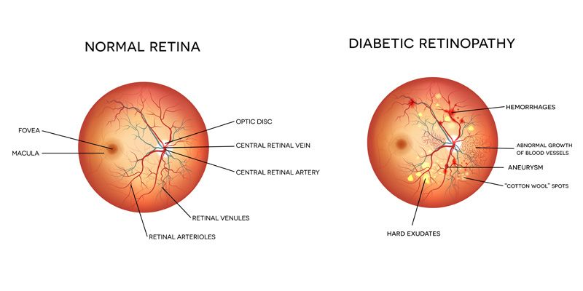
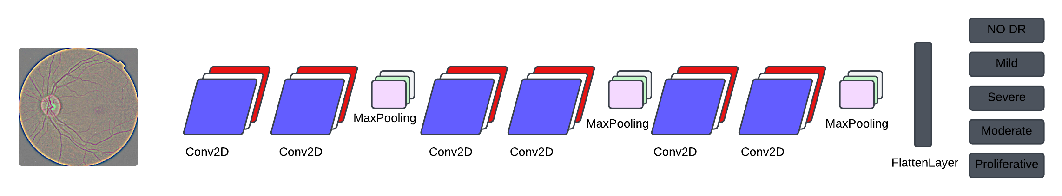
Diabetic Retinopathy
Problem Statement:
DR, caused by diabetes-related blood vessel damage, can lead to blindness if untreated, especially impacting rural areas with limited screening facilities.
Challenges:
Requires image analysis expertise.
Conflicting needs: Accuracy vs. Accessibility.
Involves patients, clinics, and healthcare providers.
Dataset:
Kaggle: Diabetic Retinopathy 224x224 (2019 Data)

